Slide 1
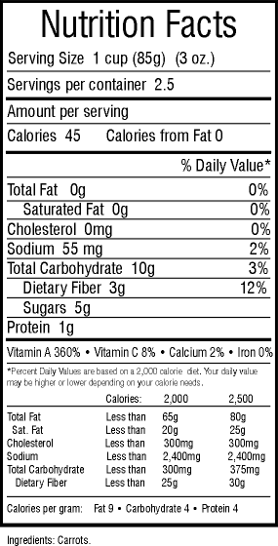
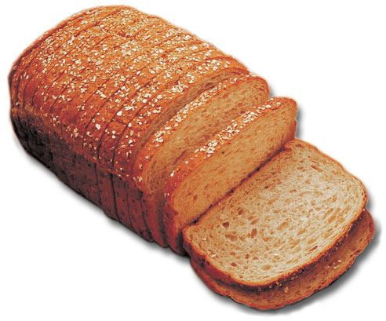
Carbohydrate Counting for Patients With Diabetes
Review Date 4/08 D-0503

Slide 2
Program Objectives
At the end of the session you will know how to:
Define carbohydrate counting
Identify the relationship between carbohydrates and blood sugar
Determine the grams of carbohydrate in foods when using the nutritional food label and other carbohydrate-counting tools
Calculate the total grams of carbohydrate/meal

Slide 3
Relationship Between Carbohydrate and Blood Sugar
The digestive system converts most digestible carbohydrates into glucose (also known as blood sugar)
Cells are designed to use this as a universal energy source
As blood sugar levels rise in a nondiabetic individual, beta cells in the pancreas churn out more and more insulin, a hormone that signals cells to absorb blood sugar for energy or storage

Slide 4
Carbohydrate and Blood Sugar in Diabetes
Individuals with type 1 diabetes—the pancreas does not make any insulin so their cells can't absorb sugar
Individuals with type 2 diabetes—the pancreas does not make enough insulin or the insulin is not effective because the cells are insulin resistant
Carbohydrates begin to raise blood glucose within approximately 5 minutes after initiation of food intake
Carbohydrates are converted to nearly 100% blood glucose within about 2 hours
Notes:
.

Slide 5
Carbohydrate and Blood Sugar in Diabetes
The focus of carbohydrate counting is on the 1 nutrient that most impacts blood glucose
Carbohydrate is the primary nutrient affecting blood glucose levels
Individuals can learn to relate carbohydrate intake with their blood glucose results

Slide 6
Carbohydrate and Blood Sugar in Diabetes
All patients with diabetes should test their blood glucose before and 2 hours after the first bite of the meal
This is the only way to tell how the choices and amount of carbohydrates consumed affect their blood sugar

Slide 7
Blood Sugar Target Ranges
Fasting/before meals: 90-130 mg/dL
After meals (2 hours after first bite):
<180 mg/dL or 30-50 mg/dL increase from premeal to postmeal

Slide 8
Carbohydrate and Blood Sugar in Diabetes—Example
Mr. S consumed 90 g of carbohydrate for breakfast (day 1)
Blood sugar premeal=115 mg/dL
Blood sugar postmeal=205 mg/dL
Mr. S consumed 45 g of carbohydrate for breakfast (day 2)
Blood sugar premeal=125 mg/dL
Blood sugar postmeal=150 mg/dL

Slide 9
Carbohydrate (CHO) Counting Defined
A meal-planning approach for all patients with diabetes, based on the following ideas:
Carbohydrate is the main nutrient affecting postprandial glycemic response
Total amount of carbohydrates consumed is more important than the source of carbohydrates

Slide 10
Benefits of Carbohydrate Counting
More flexible than other meal-planning methods
Sugar is not forbidden
Focuses attention on the foods that are most likely to make blood glucose levels go up

Slide 11
Foods That Contain Carbohydrates
Breads, cereals, pasta, and grains
Rice, beans, and starchy vegetables (potatoes, corn, peas)
Fruit and fruit juices
Milk and yogurt
Regular soda, fruit drinks, jelly beans, and gum drops
Cakes, cookies, and chocolate candy

Slide 12
Follow these rules:
2 to 3 servings of nonstarchy vegetables
2 servings of fruit
6 servings of grains, beans, and starchy vegetables
2 servings of low-fat or fat-free milk
About 6 oz of meat or meat substitutes
Small amounts of fat and sugar
* Page 2 in your book “Choose your Foods”

Slide 13
IMPORTANT!
Eat meals at the same times
Never skip meals
Eat 3 meals a day and healthy snacks between meals
Your goal is 45 – 60 g of carbohydrates per meal
This method focuses on counting carbohydrates
It doesn’t mean that you can eat as much foods as you want from groups that don’t contain any carbohydrates!

Slide 14
Grams of Carbohydrate (per Food Category)
Starch 1 serving equals about 15 g carbohydrate
Fruit: 1 serving equals about 15 g carbohydrate
Milk: 1 serving equals about 12 g carbohydrate
Nonstarchy Vegetables: 1 serving equals about 5 g carbohydrate
* Open your book on page 4

Slide 15
Starches

Slide 16
Starch Group
Each amount listed below=15 g carbohydrate
1 oz of bagel, bread, roll (1 slice of bread, one fourth of a bagel)
¾ C unsweetened cereal (Cheerios®, Rice Krispies®, corn flakes)
⅓ C higher-carbohydrate cereals (raisin bran)
One half of an English muffin
⅓ C cooked pasta, spaghetti, macaroni and cheese
⅓ C cooked brown or white rice
½ C mashed potatoes
½ C corn, beans, chickpeas, peas
1 small baked potato (3 oz)

Slide 17
Important things to know about starch group
6 exchange choices from this group are preferred
Remember that fiber is a type of complex carbohydrate
Make sure that half of your 6 exchanges are whole grain
It is easy to spot high fiber foods in your book. They have a smiley face next to them

Slide 18
Fruits and Fruit Juices

Slide 19
Fruit Group
Each amount listed below=15 g carbohydrate
1 small fresh fruit (4 oz)
½ C canned fruit (in natural juice)
2 Tbsp raisins
17 grapes
½ C fruit juice
1 C fresh fruit (cut up)
1 Tbsp jelly, jam

Slide 20
Milk and Yogurt

Slide 21
Milk Group
Each amount listed below=approximately 12 g carbohydrate
8 fl oz of skim, 1%, 2%, or whole milk
1 C plain yogurt
1 C plain or vanilla soy milk

Slide 22
Vegetables

Slide 23
Vegetables
Vegetables are counted as 5 g carbohydrate for the following servings sizes:
½ C cooked vegetables
1 C raw vegetables

Slide 24
Foods Without Carbohydrate
Protein and fat groups contain 0 g carbohydrate
Examples:
Protein: Meat, fish, poultry, cheese, eggs, peanut butter, cottage cheese, tofu
Fat: Butter, oils, margarine, mayonnaise, cream cheese, sour cream, nuts, seeds, avocado, salad dressing

Slide 25
Carbohydrate Counting Hand Guide

Slide 26
Tools for Carbohydrate Counting
Nutrition Labels
Measuring Tools

Slide 27
Food Labels
Total Carbohydrate—includes grams of sugar, sugar alcohol, starch, and dietary fiber
Total Grams of Carbohydrate—to determine amount of carbohydrate eaten, multiply grams of total carbohydrates on the label by the number of servings eaten

Slide 28
Carbohydrate Substituting
When carbohydrate counting, it is possible to substitute 1 food item for another for a similar impact on blood glucose
Example: Exchange 1 small apple (4 oz) for 2 small cookies for a similar effect on blood glucose

Slide 29
Carbohydrate Allowances for Meals and Snacks
Patients with diabetes should work with a registered dietitian or certified diabetes educator to receive an individualized meal plan, which includes how many total carbohydrates they should consume at meals and snacks
A general guideline for patients is 45-60 g/meal and 15-30 g/snack

Slide 30
Sample Menu Breakfast
How many carbohydrates are in this meal?
30 g
1½ C of Cheerios=
Small banana (4 oz)=
8-fl-oz 1% milk=
1 egg=
TOTAL=
15 g
12 g
0 g
57 g

Slide 31
Sample Menu Lunch
How many carbohydrates are in this meal?
30 g
2 slices of bread=
17 grapes=
1 C raw carrots=
3 oz tuna fish=
1 tsp mayonnaise=
15 g
5 g
0 g
0 g
Total = 50 g

Slide 32
Sample Menu Dinner
How many carbohydrates are in this meal?
68 g
1½ C pasta=
1 oz of bread=
1 C salad =
1 tsp olive oil=
15 g
5 g
0 g
Total = 88g

Slide 33
Conclusions
Carbohydrate counting is a meal-planning approach to help people with diabetes attain and maintain blood sugar control
Carbohydrate counting provides flexibility and helps people increase their confidence to manage diabetes
Patients should consult a registered dietitian or certified diabetes educator to help them master carbohydrate-counting skills

Slide 34
References
Thomas E. Survey reveals shortfall in pediatric nurses' knowledge of diabetes. J Diabetes Nurs. 2004;8:217-221.
American Dietetic Association, American Diabetes Association. Exchange Lists for Meal Planning. 2nd ed. Alexandria, VA: American Diabetes Association; 2003.
American Diabetes Association. Standards of Medical Care in Diabetes. Diabetes Care. 2007;30:S4-S41.
Warshaw H, Kulkarni K. American Diabetes Association Complete Guide to Carbohydrate Counting. Alexandria, VA: American Diabetes Association; 2004.
Warshaw H, Bolderman K. Practical Carbohydrate Counting. A How to Teach Guide for Health Professionals. Alexandria, VA: American Diabetes Association; 2001.

Slide 35
Thank You!
Questions?

